Slide 1
DNA Sequences
Watermark Encoding
Omar Zaman

Slide 2
Motivation
We need a better storage than typical silicon ssd or magnetic based hdds
We can store data in DNA strands with the 4 bases A,C,G,T being a quaternary basis
The problem lies that when reading the data enzymes will cause the DNA sequence to change by inserting, deleting and substituting bases in the sequence
This can be modelled as an insertion, deletion substitution channel and for our purposes can be treated as memoryless with Pi, Pd and Ps being the probabilities of there respective changes.
Notes:
In this digital age data storage is becoming increasingly more important with many corporations and governments needing vast resources to store all the data they mine.
We typically store data in hdds, the magnetic material is divided into segments where the direction of its magnetic field encodes a bit – if its up it’s a one or its down it’s a zero
Or in sdds we store the charge in an integrated circuit
So we need an advancement to this technology which can be done via DNA storage
2ND line
With DNA storage being around 10^8 more data dense than our typical silicon ssd storage

Slide 3
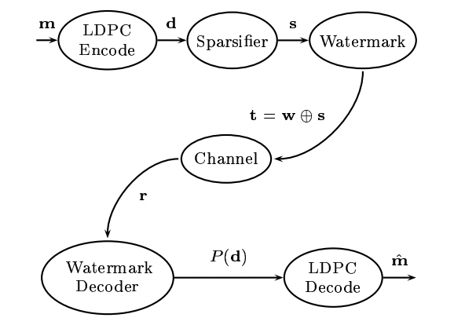
Watermark Encoding
ATG GTG GGC
ATG GTT GGA
ATGA GT_ GTA
Watermark sequence
Encoding Sparse
information
Transmitted sequence
Channel
Received sequence
Notes:
The way were going to try and solve the problem of the insertion ,deletion, substitution channel is via watermark encoding
We can ignore the LDPC encoder and decoder for now on this diagram from davey mckays paper on watermark encoding,
We have a sparsifier which gives us our sparse information sequence and that sequence is added module two addition with a known watermark sequence in the binary domain,
Then the channel causes insertions deletions and substitutions
Point out to the dna sequence
By using watermark encoding we have a known sequence with information sparsely encoded by substitutions.
Therefore the problem we are trying to solve is given the received sequence and the watermark sequence what is the transmitted information sequence.

Slide 4
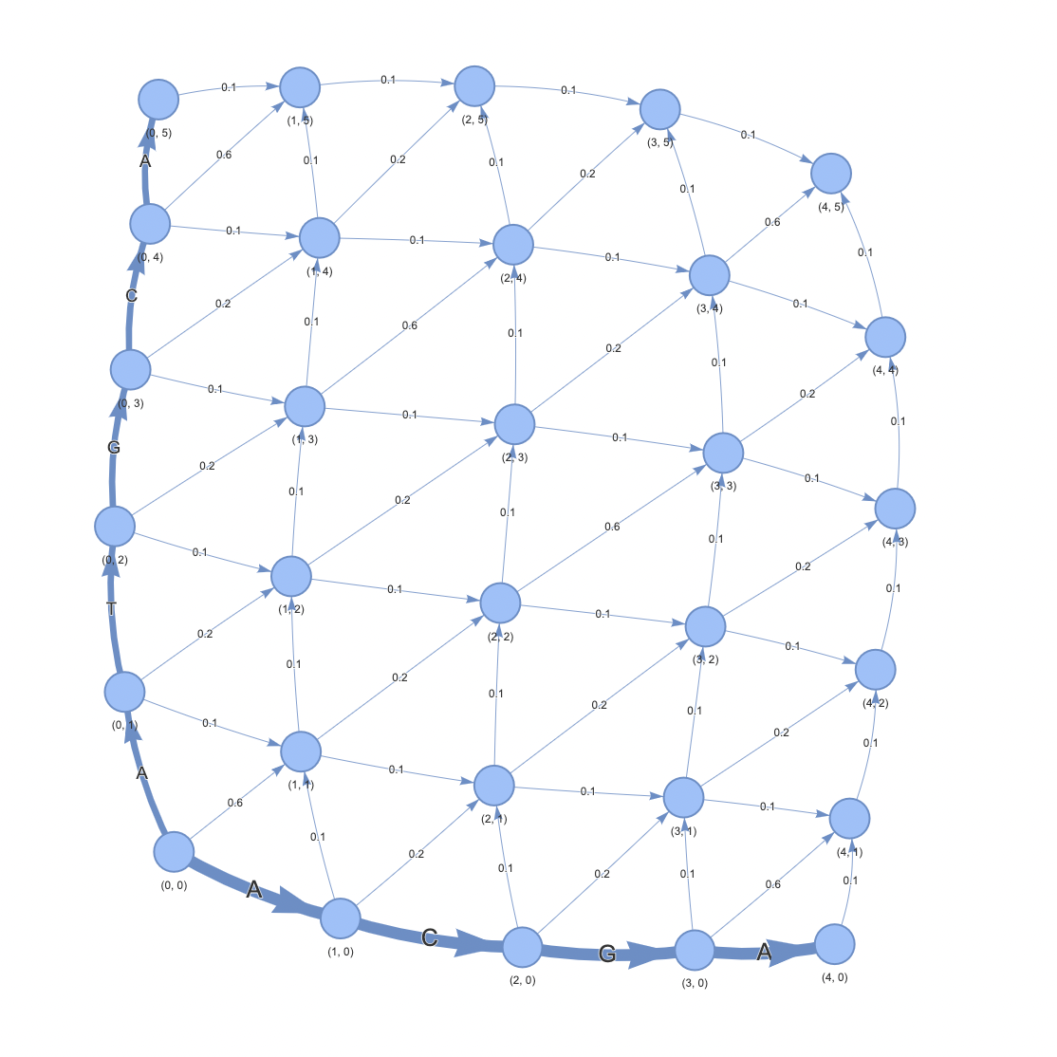
Trellis Algorithm
Forward Backward Algorithm applied
Forward pass to calculate alphas using product sum
Similarly for backwards to calculate betas
Then use transition probabilities with alphas and betas to calculate the likelihoods for substitution and transmission
Notes:
Trellis algorithm for decoding the watermark – different to my colleague art who is using the trellis suggested by davey mckay that looks at the nodes drift state
This trellis implementation only looks at one insertion at a time for each node
Dynamic programming top down recursive, bottom up tabulated much quicker
We run a product sum algorithm – incoming nodes to get the alpha values in forward pass and similarly for backwards pass
Then we use the transition probabilities with the alphas and betas to get likelihoods for substitution and transmission
This gives us soft outputs for each transmitted sequence on whether it believes there was a transmission or subsitutions – feed into ldpc decoder to make a hard decision but were just gonna use these likelihoods with a threshold to essentially decide on the transmitted sequence

Slide 5
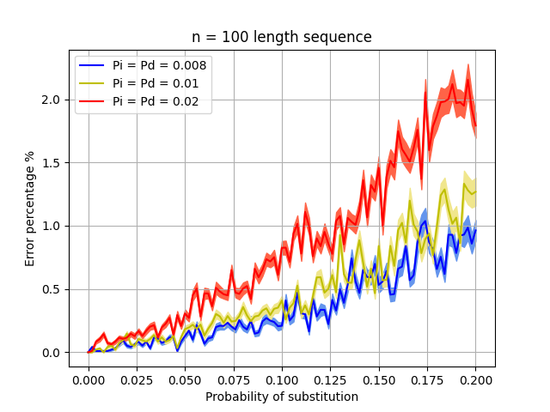
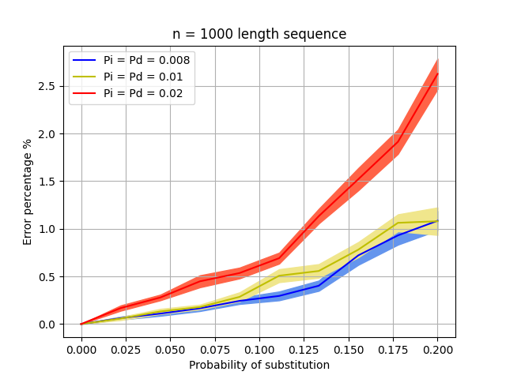
Binary Data
Probability of substitution Ps is essentially the transmission rate as it’s the number of encoded information symbols per transmitted symbols
Notes:
Binary data
Generated n length binary sequences which went through our insertion,deletion substitution channel and then we tried decoding the transmitted sequence via our trellis
Same Pi , Pd to keep expected length the same
Noisy with n = 100 length sequences – represents the randomness of the sequences we used
N = 1000 length higher error percentage at the end error propagation less.effect on the noise longer sequences.

Slide 6
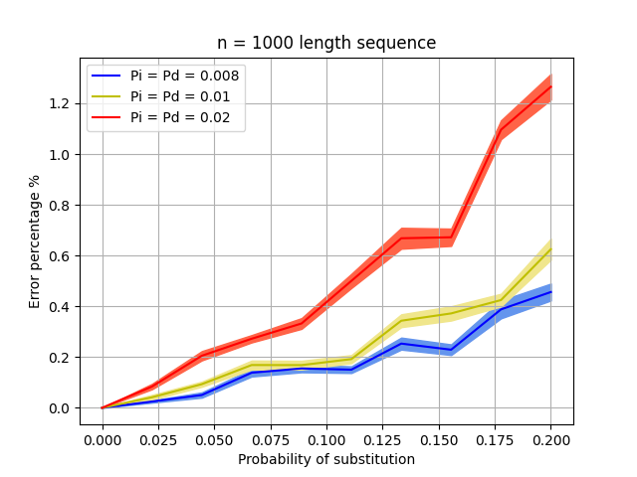
DNA bases data
There are two types of error being accounted
When the trellis predicts a substitution when a transmission has occurred
Or when the trellis predicts a transmission even though a substitution has occurred
These errors mean that either information encoded in the watermark is missed or we add information in which wasn’t actually transmitted
Notes:
Quarternary basis – much smaller error percentage because the sequences are far more distinct in quarternary than binary

Slide 7
Further Tasks
Input likelihoods from trellis to LDPC decoder to get hard outputs
Reed Solomon codes also need to implemented for packet loss
Include the effects of non memory less channel because for real sequences a HMM is a more appropriate
A potential optimisation technique could be to use genetic evolutionary algorithms with each generation producing more probable sequences
Notes:
For the current Trellis implementation the forward backwards soft outputs need to be inputted into an LDPC decoder and find its performance in correctly determining the encoded information sequence
`A potential way of solving this would be to perhaps use an optimisation technique with the objective function being the probability of a proposed dna sequence with the encoded information given the watermark and transmitted sequence
The search space would be all potential DNA sequences of the same length as the watermark sequence

